Slide 1







•
• •
I
•
Leveraging Machine Learning for Environmental Forecasting
Authors: Nikhil Gowda HL, Nithin D, Prajwal R
Department of Agricultural Statistics I GKVK, Bangalore

Slide 2


Slide 3





ore esearc
A Data-Driven Perspective
Climate change poses a critical threat to ecosystems. This study leverages ML techniques including Linear Regression, Random Forest, and Gradient Boosting to model climate indicators using synthetic data patterned after NASA/NOAA records.
� Prediction accuracy up to 92% in comparative studies.

Slide 4



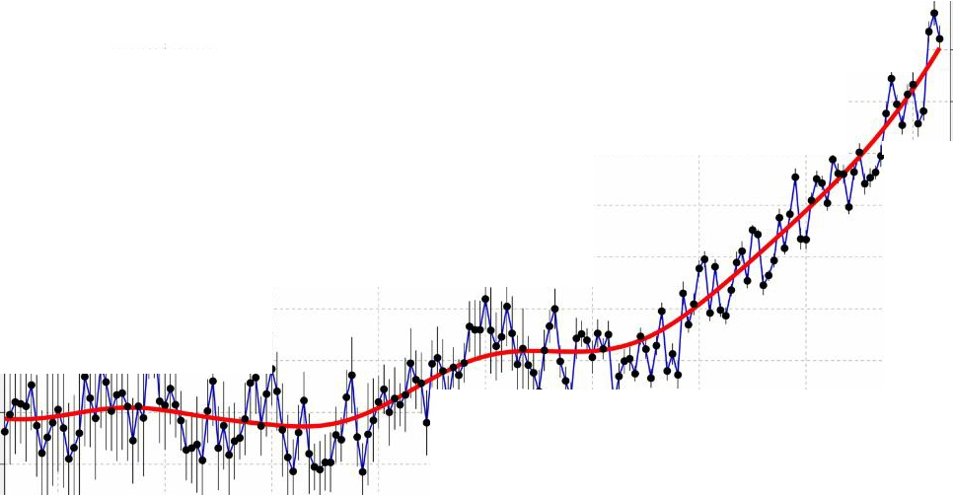
Limitations of Current Models
'
-u
Traditional climate models (GCMs) provide broad insights but often lack the spatial resolution for local forecasting.
Integrating ML with observational data presents challenges in handling noisy, multi-source datasets.
Global Average Temperature 1850 - 2025
''
1.6
'
''
''
---
'
''
1.4 0
•••
j
--
-
. - ..'. -
'
''
''
'
''
1.2 r>o⁻
'
'
'
E
0
C
<(
0.8 <D
1-
'
'
'
··•-:••·· 1
----- --- ---------------------------- - ---�'------------- -------- - ------- -------------------- ------- -------------- -------------- - --
''
'' '
'
''
''
''
'' '
'
'' '
'
::::1
,'' .
''
o.6 1u
'
''
'
'
'
'
'
'
'
'
1-
(J)
''
0.4 a..
0 Computational and conceptual limitations.
I;
'
''
E
''
''
'
0.2 �
'
'
-
''
···t.an·d·aata·p eparecrby s·erkeley Earth·and combin¢d• with oce13n data adapted from the UK Hadley Cen\'re
Global temperature anomalies relative to 1850-1900 average Vertical lines indicate 95% confidence interva' ls
0 i
'
₋0
Noise in atmospheric and oceanic variables.
'
'
''
-0.2 <.9
ti Need for higher granular accuracy.
1860 1880
1900 1920 1940 1960 1980 2000 2020

Slide 5






esearc
Global Warming
Natural Disasters
Agri-Dependency
Increasing temperatures highlight the urgent need for robust prediction systems.
Floods, droughts, and cyclones require advanced forecasting for mitigation.
Indian agriculture depends heavily on climate-sensitive seasonal cycles.

Slide 6



r1
•
</>
Model Development: Build robust predictive models using Linear Regression, Random Forest, and Gradient Boosting.
(Ji)
Data Integration: Consolidate diverse climate sources patterned after NASA/NOAA historical records.
•✓ Preprocessing: Apply rigorous cleaning and Min-Max normalization for high-quality data input.
;
Performance Benchmarking: Evaluate models using MSE, R², and MAE metrics to identify optimal techniques.

Slide 7






verv1•e
A synthetic climate dataset mimicking realistic trends in CO₂ and Average Annual Temperature.
Vear Instance
CO
2
Concentration
(ppm)
Average Temperature (°C)
Record Frequency
1980
350.99
9.82
Annual Baseline
1990
364.55
10.15
Decade Interval
2000
379.20
10.42
Millennium Marker
2010
394.85
10.88
Growth Phase
2020
410.51
11.34
Current Trend

Slide 8


•
•
Preprocessing
Engineering
Modeling
Evaluation
Cleaning, handling missing values, and scaling features (0-1).
Feature selection of Year and CO₂ as primary indicators.
Implementation of LR, RF, and GB algorithms in Python.
Comparative analysis using MSE and R2 scores.

Slide 9
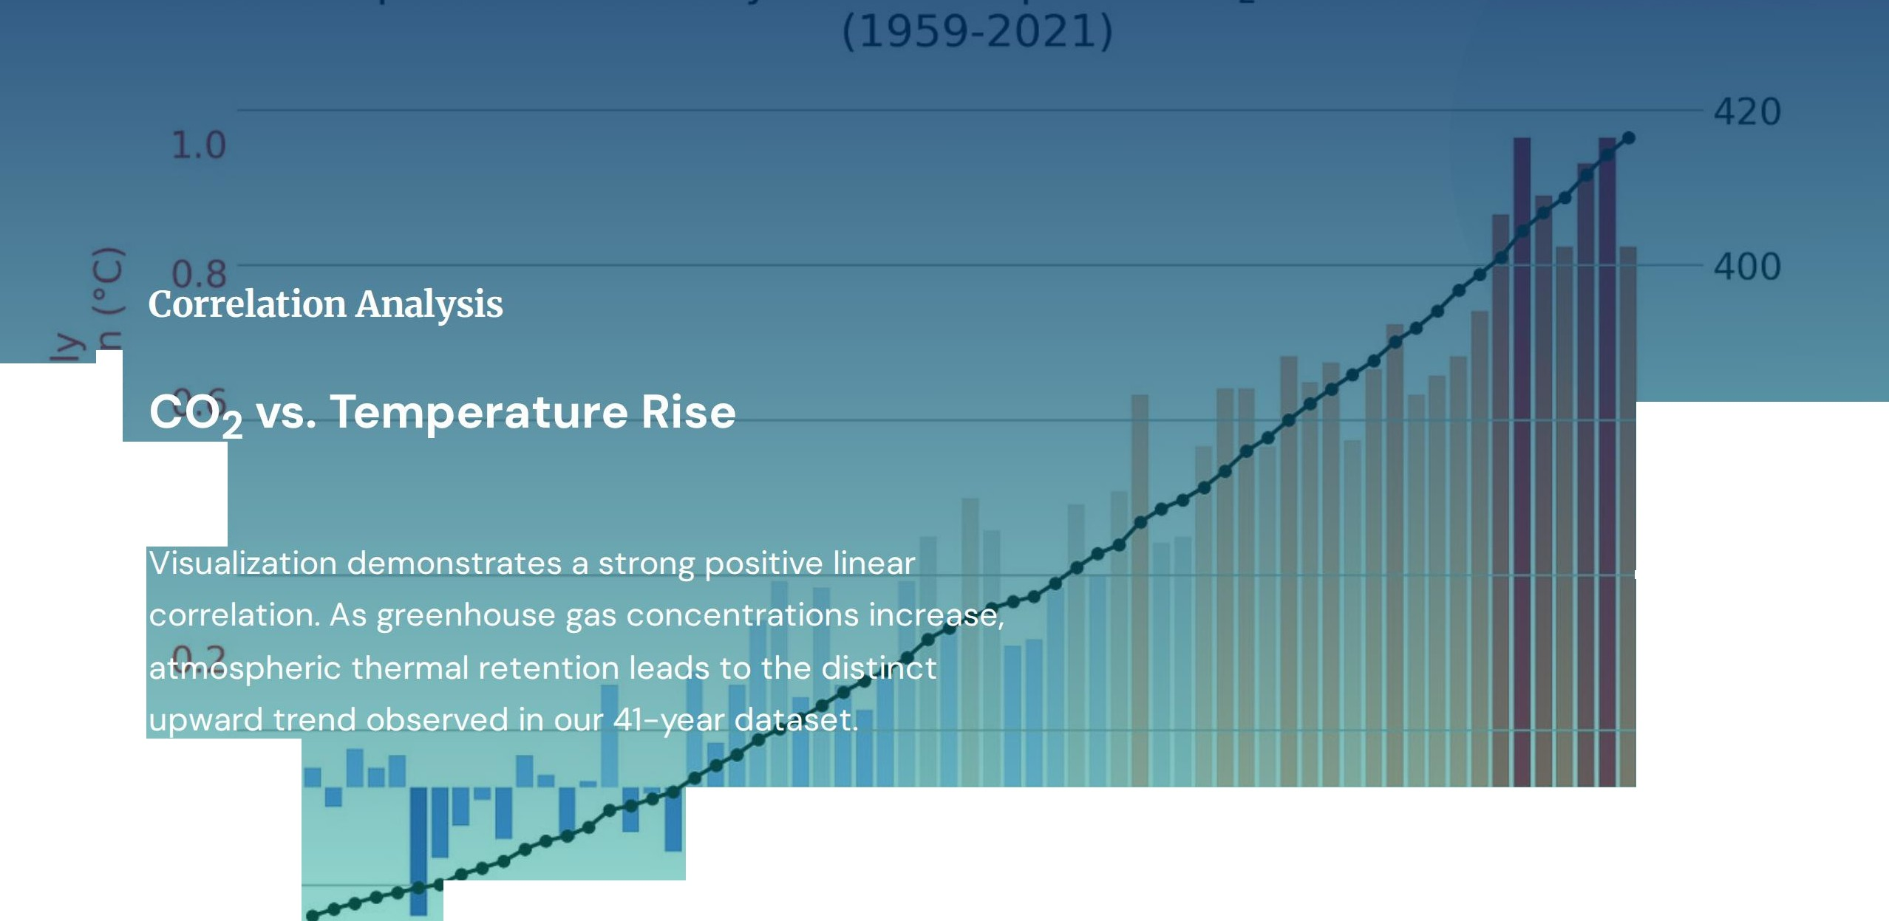

ca co
E a,
oE
-380
.,a ⁷ ..
^{c}ca^{:o}co
E
a.
Q) I
0.4
..,ª,..
L. r-f
::s Ln
^{I}c•o °r'-f
-3600
(1) A
u
L.
C.
E�
� ·r,
(0
QJ
\._
340
0.0
​�
�320
-0.2
1960
1970
1980
2000
2010
2020

Slide 10




ance enc
Linear Regression
Random Forest
Gradient Boosting
Insight: Ensemble methods outperform simple regression by capturing non-linear residuals effectively. Gradient Boosting achieved the minimum Mean Squared Error (0.043).

Slide 11






r1• cu ura
��::;;-..;';�=:--.;::--�;::_
•
Smart Irrigation Control
Real-time Weather Alerts
Optimized Yield Prediction

Slide 12






•
•
Thank you for your time and attention.
Contact Info:
Project Code:
Nikhil Gowda I Nithin D I Prajwal R
EAl421 Lab Implementation
UAS Bangalore I GKVK Campus
Python / Google Colab

Slide 13




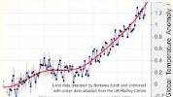



ources
https://www.clipartmax.com/png/middle/285-2853046_by-http-myexamportal-university-of-agricultural-sciences-bangalore-logo.png
Source: www.clipartmax.com
https://png.pngtree.com/png-vector/20250321/ourlarge/pngtree-earth-divided-a-visual-representation-of-climate-change-png-image_l5821773.png
Source: pngtree.com
https://berkeley-earth-wp-offload.storage.googleapis.com/wp-content/uploads/2026/01/13155613/2025-Time-Series.png
Source: berkeleyearth.org
https://www.anernstore.com/cdn/shop/articles/Solar_panels_powering_a_drip_irrigation_system_in.png?v=1755070975&width=1200
Source: www.anernstore.com
https://storage.googleapis.com/gweb-uniblog-publish-prod/images/Px0_15l_socialv2.width-1300.png
Source: blog.google
https://png.pngtree.com/thumb_back/fh260/background/20241224/pngtree-lush-green-field-with-majestic-mountain-landscape-in-the-background-capturing-image_l685 2210.jpg
Source: pngtree.com

Slide 14

ources
https://miro.medium.com/v2/resize:fit:1400/l*PEz2rFdsaF_ vHkM5JHgSBw.jpeg
Source: medium.com

